Slide 1
Vectors
Pre-class (1 to 16)
in-class (18 onwardS)

Slide 2
Scalars
A physical quantity that is completely described by its magnitude is called a scalar.
Examples of scalars are :
Mass
Volume
Work and energy
Time
Density
Temperature
Obviously mass, volume, temperature, time, etc. cannot have directions.

Slide 3
Scalars
Scalars can be added/subtracted using algebraic addition/subtraction.
For example, 2.0 kg + 3.0 kg = 5.0 kg.
Some physical quantities like length and area are treated as vectors by giving them a direction.

Slide 4
Vectors
A physical quantity that is completely described only if both its magnitude and direction are specified is known as a vector.
If we ask someone to apply a force of 10 N, he cannot act until he knows the direction to apply the force. Hence force is a vector.
Other examples of vectors are :
velocity
acceleration
displacement
momentum

Slide 5
Graphical representation of vectors
A vector can be represented as an arrow drawn to scale.
The length of the arrow gives the magnitude of the vector and the arrow head gives the direction of the vector.
The figure below shows how a velocity vector is represented as an arrow.
North
Scale: 1 cm = 10 m/s
2.8 cm
velocity
In words : Velocity = 28 m/s in the direction of North East or 45º with respect to East.
45º
East

Slide 6
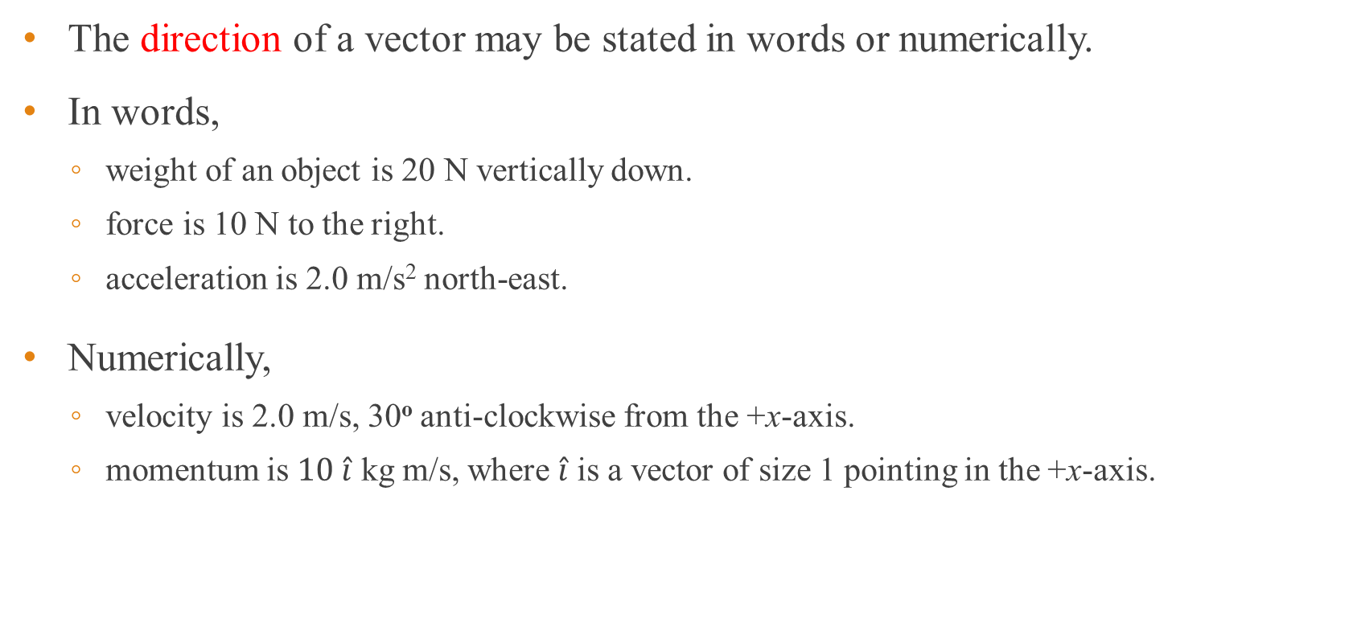
Specifying direction of a vector
The direction of a vector may be stated in words or numerically.
In words,
weight of an object is 20 N vertically down.
force is 10 N to the right.
acceleration is 2.0 m/s² north-east.
Numerically,
velocity is 2.0 m/s, 30º anti-clockwise from the +x-axis.
momentum is $10 \hat{i}$ kg m/s, where $\hat{i}$ is a vector of size 1 pointing in the +x-axis.

Slide 7
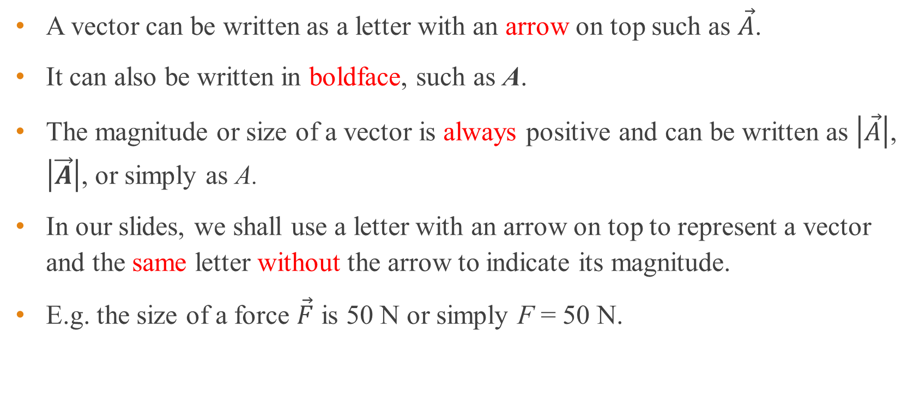
Vector notations
A vector can be written as a letter with an arrow on top such as $\vec{A}$.
It can also be written in boldface, such as A.
The magnitude or size of a vector is always positive and can be written as $\left|\vec{A}\right|$, $\left|\vec{A}\right|$, or simply as A.
In our slides, we shall use a letter with an arrow on top to represent a vector and the same letter without the arrow to indicate its magnitude.
E.g. the size of a force $\vec{F}$ is 50 N or simply F = 50 N.

Slide 8



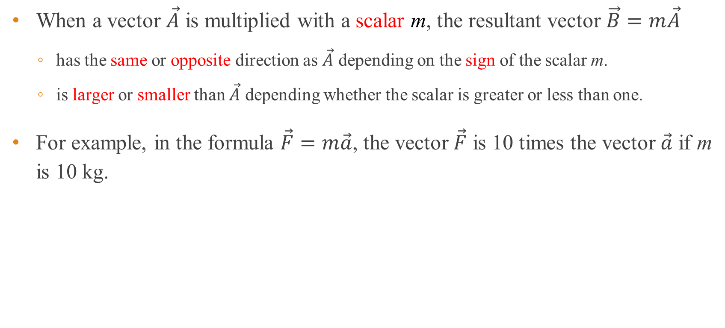



Scalar multiplication
When a vector $\vec{A}$ is multiplied with a scalar m, the resultant vector $\vec{B}=m\vec{A}$
has the same or opposite direction as $\vec{A}$ depending on the sign of the scalar m.
is larger or smaller than $\vec{A}$ depending whether the scalar is greater or less than one.
For example, in the formula $\vec{F}=m\vec{a}$, the vector $\vec{F}$ is 10 times the vector $\vec{a}$ if m is 10 kg.
$${\vec{F}}_{1}$$
$${\vec{F}}_{1}$$
$${\vec{F}}_{1}$$
$${\vec{F}}_{2}=−2{\vec{F}}_{1}$$
$${\vec{F}}_{2}=2{\vec{F}}_{1}$$
$${\vec{F}}_{2}=−\frac{1}{2}{\vec{F}}_{1}$$

Slide 9
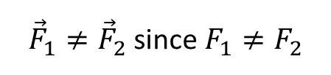

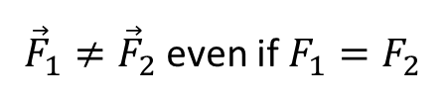




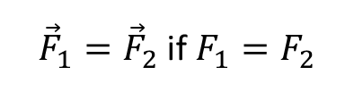

Equality of vectors
Two vectors are equal if they have the same magnitude, are parallel and in the same direction.
In the figure below, only the first pair of vectors are equal.
$${\vec{F}}_{1}$$
$${\vec{F}}_{1}$$
$${\vec{F}}_{1}$$
$${\vec{F}}_{2}$$
$${\vec{F}}_{2}$$
$${\vec{F}}_{2}$$
${\vec{F}}_{1}={\vec{F}}_{2}$ if $F_{1}=F_{2}$
${\vec{F}}_{1}≠{\vec{F}}_{2}$ even if $F_{1}=F_{2}$
${\vec{F}}_{1}≠{\vec{F}}_{2}$ since $F_{1}≠F_{2}$

Slide 10





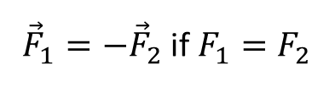
Negative vectors
Two vectors are negative of each other if they have the same magnitude, are parallel but in opposite directions.
In the figure below, only the vectors in the first pair of vectors are negative of each other.
$${\vec{F}}_{1}$$
$${\vec{F}}_{1}$$
$${\vec{F}}_{2}$$
$${\vec{F}}_{2}$$
${\vec{F}}_{1}=−{\vec{F}}_{2}$ if $F_{1}=F_{2}$
$${\vec{F}}_{1}≠−{\vec{F}}_{2}$$

Slide 11





Triangle rule for adding two vectors
The resultant of adding two vectors is obtained by
placing the tail of the second vector at the head of the first vector
drawing a line joining the tail of the first vector to the head of the second vector.
It does not matter which vector is first and which is second.
Animation
$$\vec{B}$$
$$\vec{R}=\vec{A}+\vec{B}$$
⇒
$$\vec{B}$$
$$\vec{A}$$
$$\vec{A}$$

Slide 12
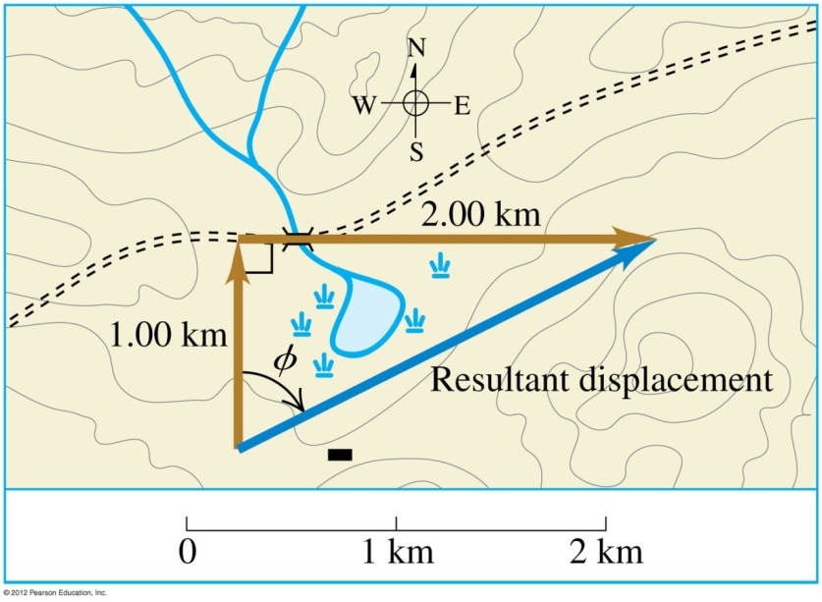
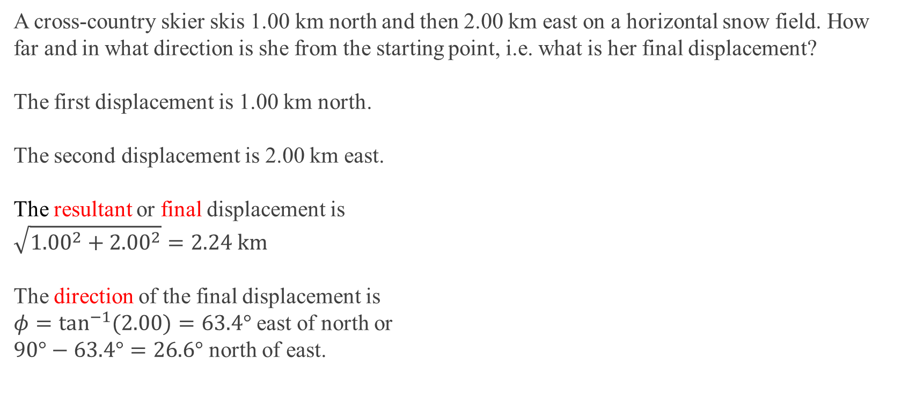
Example 1
A cross-country skier skis 1.00 km north and then 2.00 km east on a horizontal snow field. How far and in what direction is she from the starting point, i.e. what is her final displacement?
The first displacement is 1.00 km north.
The second displacement is 2.00 km east.
The resultant or final displacement is $$\sqrt{{1.00}^{2}+{2.00}^{2}}=2.24 \text{km}$$
The direction of the final displacement is $φ=\tan^{−1}{(2.00)}=63.4°$ east of north or $90°−63.4°=26.6°$ north of east.

Slide 13







Polygon rule for adding 3 or more vectors
This is an extension of the triangle rule for adding more than two vectors by drawing.
The resultant is the line joining the tail of the first vector to the head of the last vector after putting all the vectors touching head to tail.
$$\vec{B}$$
$$\vec{A}$$
$$\vec{B}$$
$$\vec{C}$$
⇒
$$\vec{A}$$
$$\vec{R}=\vec{A}+\vec{B}+\vec{C}$$
$$\vec{C}$$

Slide 14

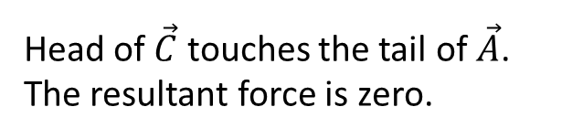





Example 2
Add the force vectors $\vec{A}$, $\vec{B}$, and $\vec{C}$. Comment on your answer.
$$\vec{A}$$
$$\vec{C}$$
$$\vec{B}$$
$$\vec{B}$$
⇒
$$\vec{A}$$
$$\vec{C}$$
Head of $\vec{C}$ touches the tail of $\vec{A}$. The resultant force is zero.

Slide 15

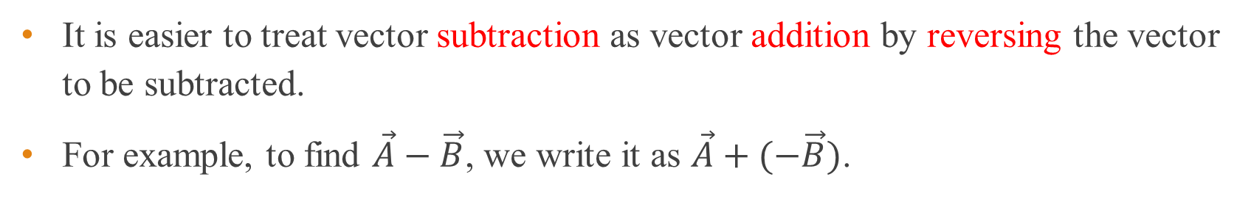




Triangle rule – Subtracting two vectors
It is easier to treat vector subtraction as vector addition by reversing the vector to be subtracted.
For example, to find $\vec{A}−\vec{B}$, we write it as $\vec{A}+(−\vec{B})$.
$$\vec{A}$$
$$\vec{B}$$
$$\vec{R}=\vec{A}+(−\vec{B})$$
$$−\vec{B}$$
$$\vec{A}$$

Slide 16



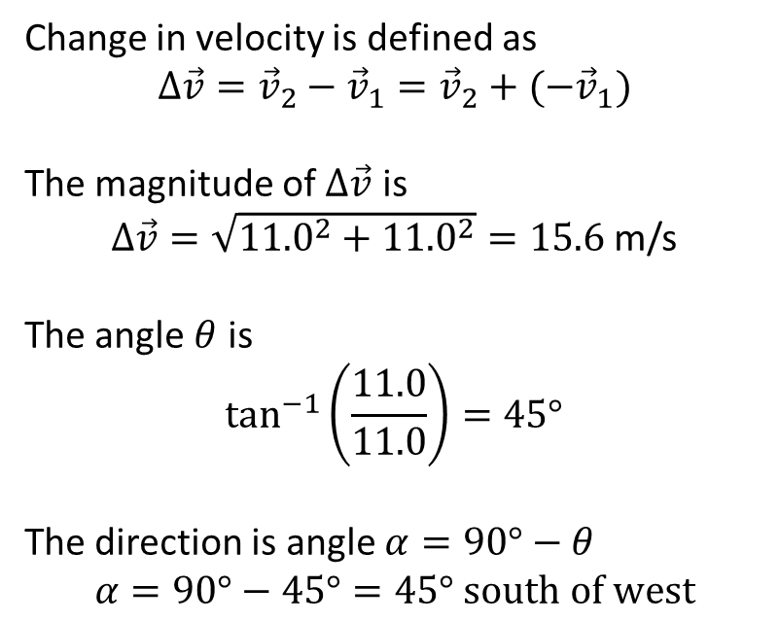



Example 3
An object is moving east at 11.0 m/s. It then changes direction to move at 11.0 m/s south. What is the change in its velocity?
Change in velocity is defined as
$$Δ\vec{v}={\vec{v}}_{2}−{\vec{v}}_{1}={\vec{v}}_{2}+(−{\vec{v}}_{1})$$
The magnitude of $Δ\vec{v}$ is
$Δ\vec{v}=\sqrt{{11.0}^{2}+{11.0}^{2}}=15.6$ m/s
The angle $θ$ is
$$\tan^{−1}\left(\frac{11.0}{11.0}\right)=45°$$
The direction is angle $α=90°−θ$
$$α=90°−45°=45° \text{south} \text{of} \text{west}$$
$${\vec{v}}_{1}$$
N
$${\vec{v}}_{2}$$
$$α$$
$$Δ\vec{v}$$
$$θ$$
$${\vec{v}}_{2}$$
$${−\vec{v}}_{1}$$

Slide 17
End of pre-class slides

Slide 18
Resolution of vectors
Since vectors can be added to form a resultant, the reverse is also possible.
Any vector can be resolved (break up) into its components.
We usually resolve a vector into mutually perpendicular components. Animation

Slide 19

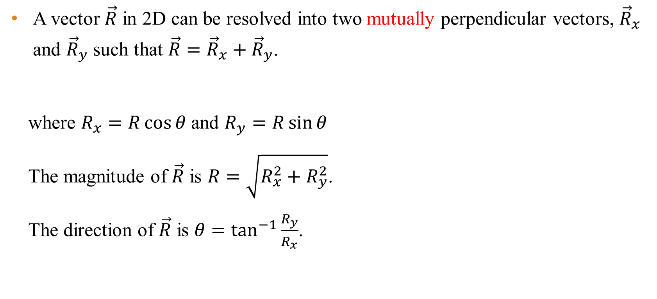



Resolving vectors in 2D
A vector $\vec{R}$ in 2D can be resolved into two mutually perpendicular vectors, ${\vec{R}}_{x}$ and ${\vec{R}}_{y}$ such that $\vec{R}={\vec{R}}_{x}+{\vec{R}}_{y}$.
where $R_{x}=R\cos{θ}$ and $R_{y}=R\sin{θ}$
The magnitude of $\vec{R}$ is $R=\sqrt{R_{x}^{2}+R_{y}^{2}}$.
The direction of $\vec{R}$ is $θ=\tan^{−1}{\frac{R_{y}}{R_{x}}}$.
$$\vec{R}$$
$${\vec{R}}_{y}$$
$$θ$$
$${\vec{R}}_{x}$$

Slide 20
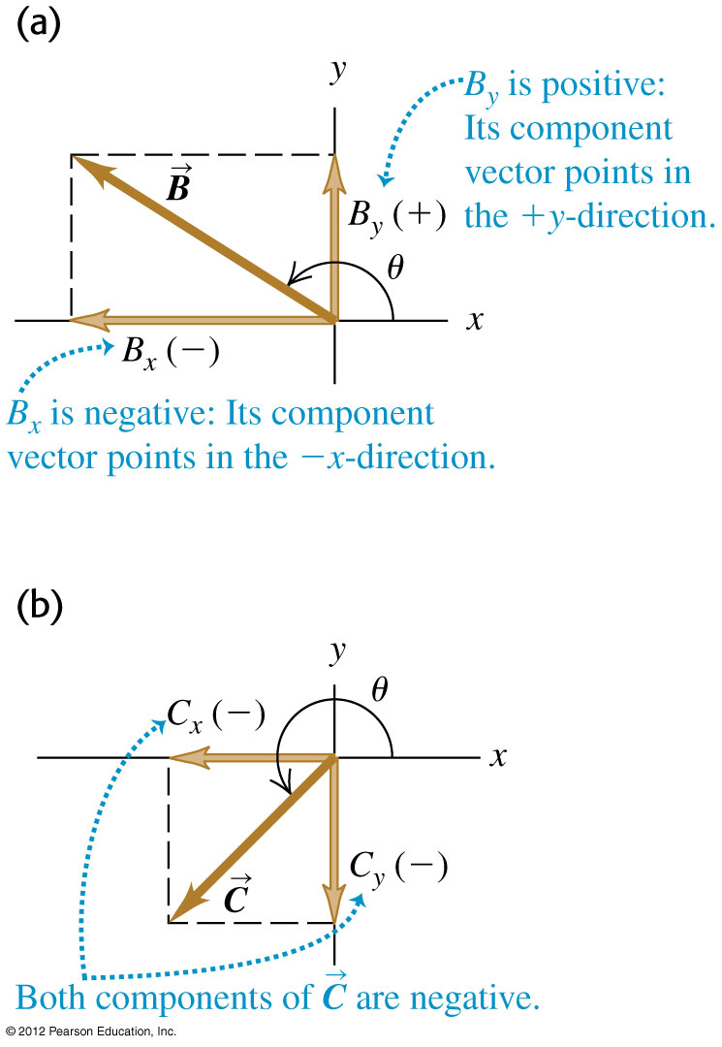
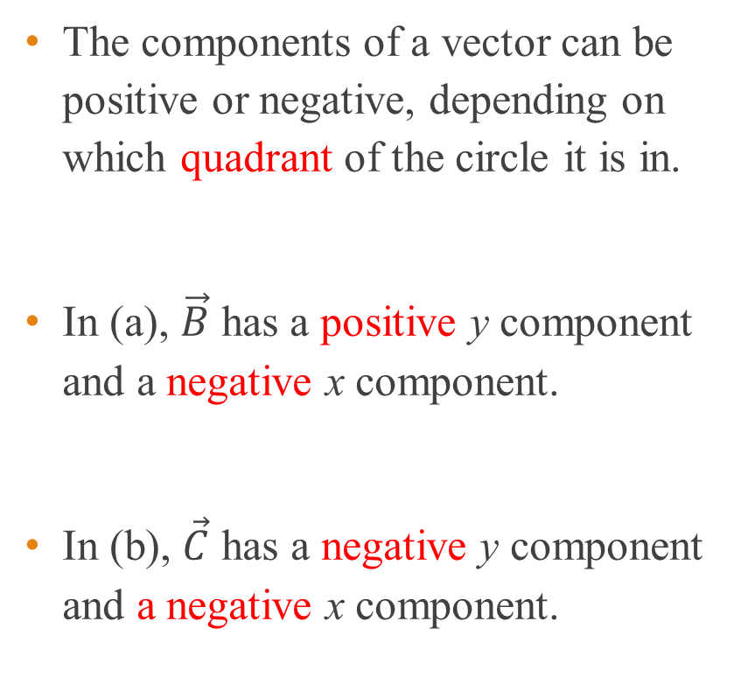
Positive and negative components
The components of a vector can be positive or negative, depending on which quadrant of the circle it is in.
In (a), $\vec{B}$ has a positive y component and a negative x component.
In (b), $\vec{C}$ has a negative y component and a negative x component.

Slide 21
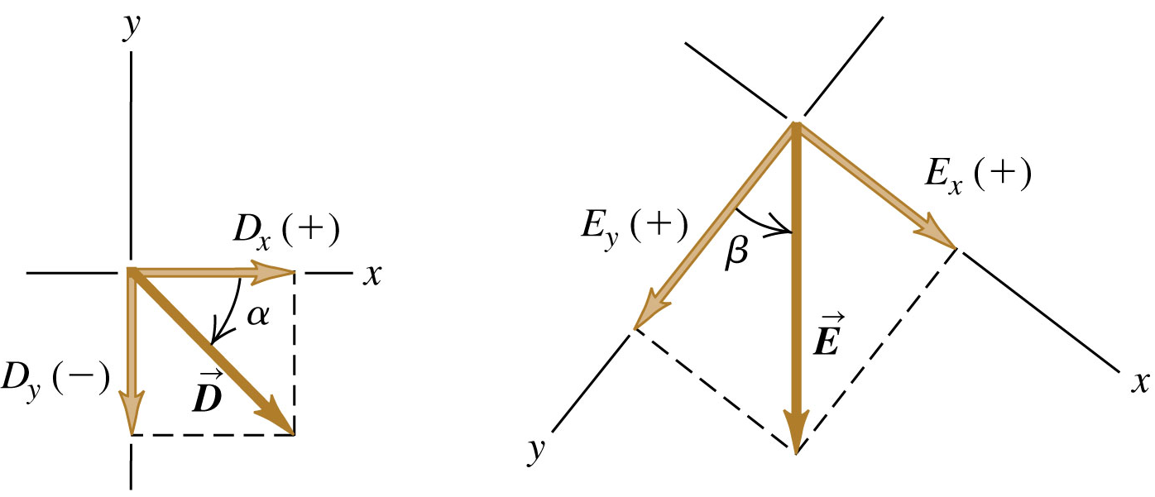
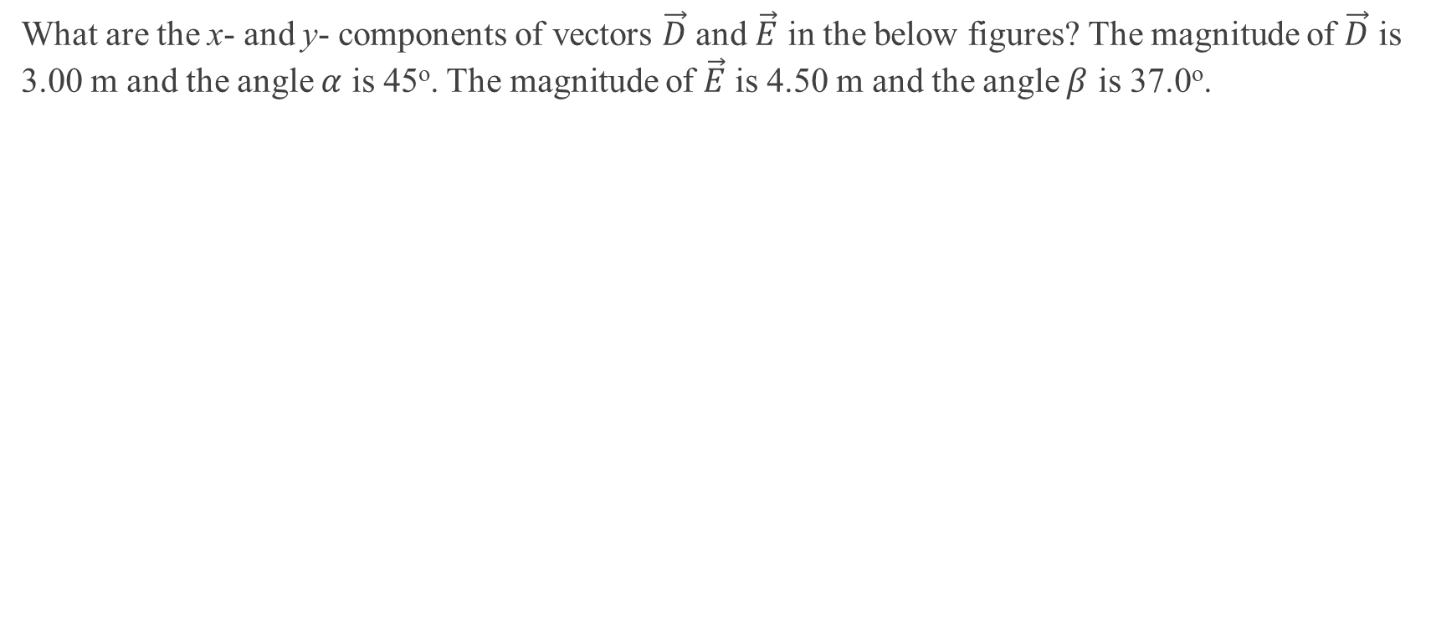
Example 4
What are the x- and y- components of vectors $\vec{D}$ and $\vec{E}$ in the below figures? The magnitude of $\vec{D}$ is 3.00 m and the angle $α$ is 45º. The magnitude of $\vec{E}$ is 4.50 m and the angle $β$ is 37.0º.
Notes:
D_{x} = +2.1 m, D_{y} = −2.1 m, E_{x} = +2.71 m, E_{y} = +3.59 m

Slide 22
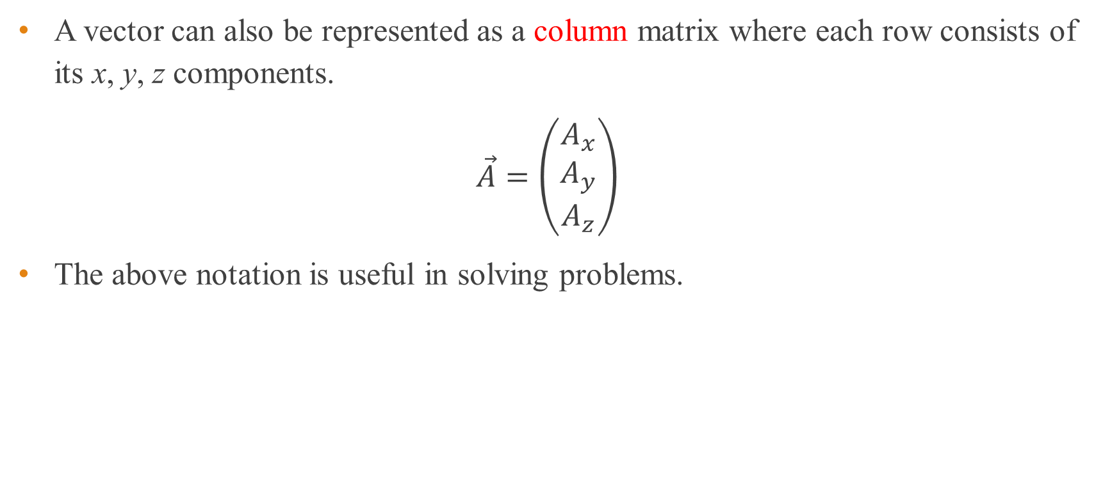
Vectors as column matrices
A vector can also be represented as a column matrix where each row consists of its x, y, z components.
$$\vec{A}=\left(\begin{matrix}A_{x} \\ A_{y} \\ A_{z}\end{matrix}\right)$$
The above notation is useful in solving problems.

Slide 23
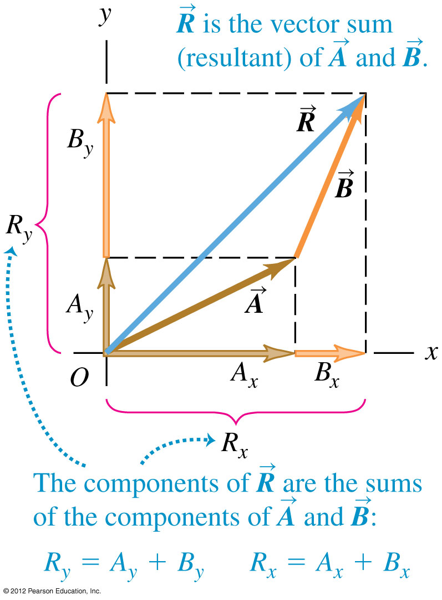
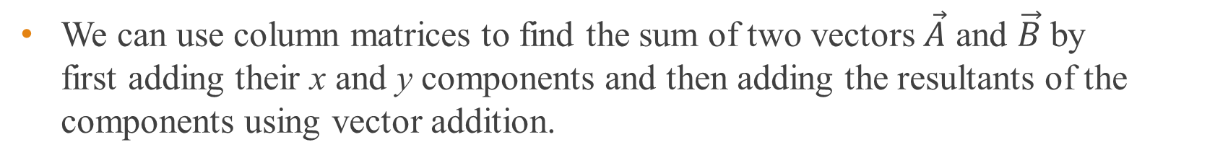
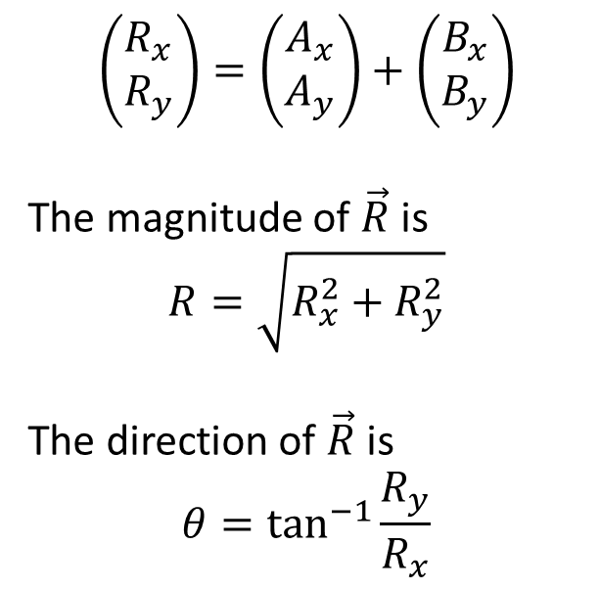

Vectors as column matrices
We can use column matrices to find the sum of two vectors $\vec{A}$ and $\vec{B}$ by first adding their x and y components and then adding the resultants of the components using vector addition.
$$\left(\begin{matrix}R_{x} \\ R_{y}\end{matrix}\right)=\left(\begin{matrix}A_{x} \\ A_{y}\end{matrix}\right)+\left(\begin{matrix}B_{x} \\ B_{y}\end{matrix}\right)$$
The magnitude of $\vec{R}$ is
$$R=\sqrt{R_{x}^{2}+R_{y}^{2}}$$
The direction of $\vec{R}$ is
$$θ=\tan^{−1}{\frac{R_{y}}{R_{x}}}$$
$$θ$$

Slide 24
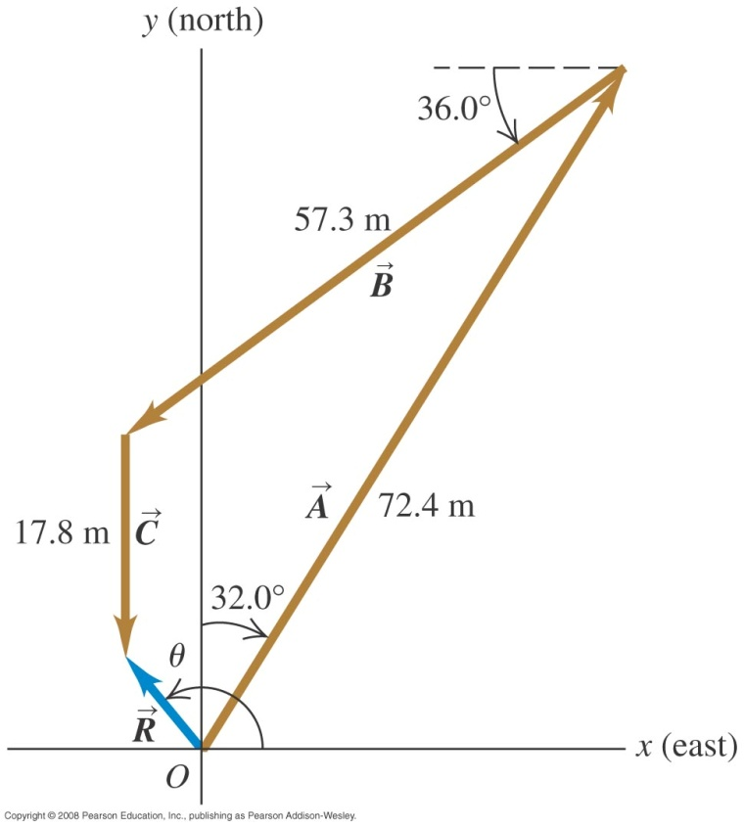


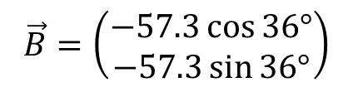

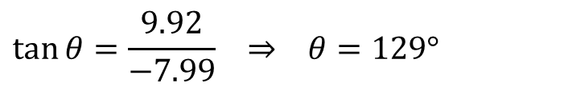

Example 5
An object starts from a point O goes to point A which is described by vector $\vec{A}$ : 72.4 m, 32.0$°$ east of north. It then moves to point B which is described by vector $\vec{B}$ : 57.3 m, 36.0$°$ south of west. Finally it moves to point C which is described by $\vec{C}$ : 17.8 m due south. Find the resultant displacement vector.
$$\vec{A}=\left(\begin{matrix}72.4\sin{32°} \\ 72.4\cos{32°}\end{matrix}\right)$$
$$\vec{B}=\left(\begin{matrix}−57.3\cos{36°} \\ −57.3\sin{36°}\end{matrix}\right)$$
$$\vec{C}=\left(\begin{matrix}0 \\ −17.8\end{matrix}\right)$$
$$\vec{R}=\vec{A}+\vec{B}+\vec{C}=\left(\begin{matrix}38.37 \\ 61.40\end{matrix}\right)+\left(\begin{matrix}−46.36 \\ −33.68\end{matrix}\right)+\left(\begin{matrix}0 \\ −17.8\end{matrix}\right)=\left(\begin{matrix}−7.99 \\ 9.92\end{matrix}\right)$$
$$R=\sqrt{{\left(−7.99\right)}^{2}+{\left(9.92\right)}^{2}}=12.7 \text{m}$$
$$\tan{θ}=\frac{9.92}{−7.99} ⇒ θ=129°$$
Notes:
R = 12.7 m, θ = −51º. This should be interpreted as 180º – 51º = 129º which is 39º west of north.

Slide 25
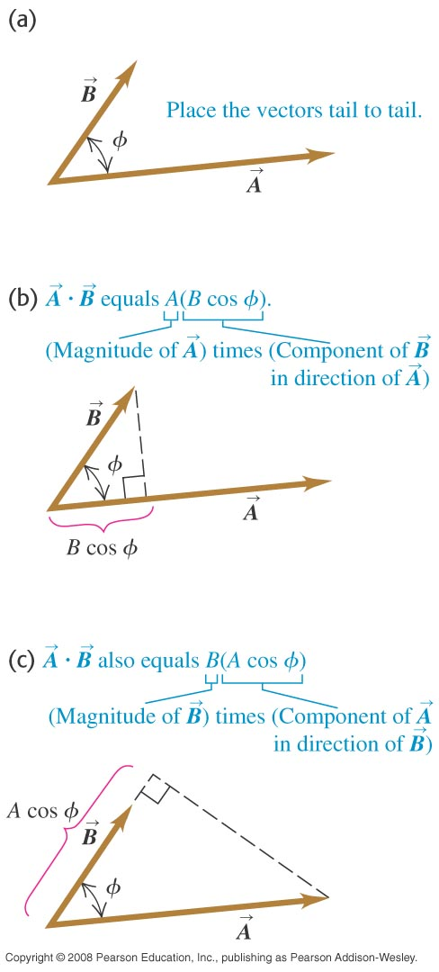
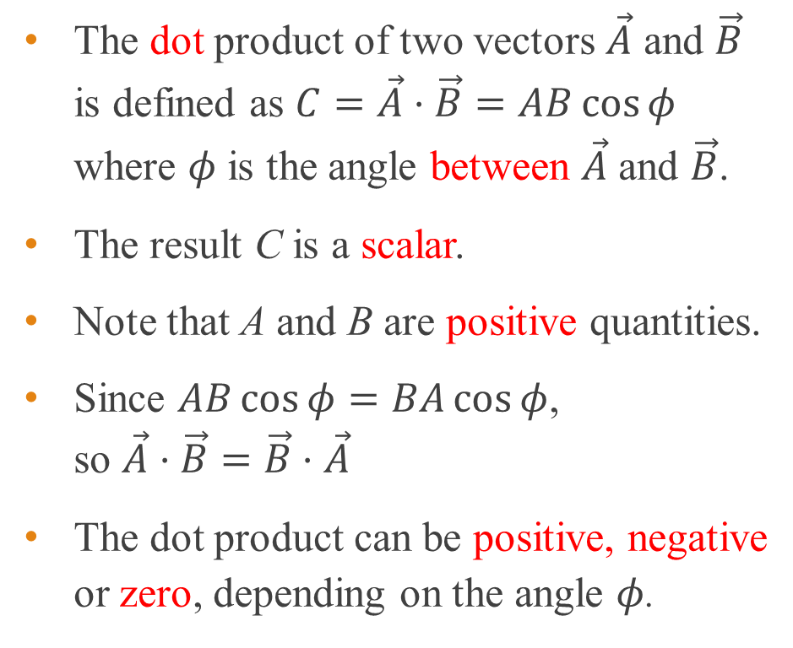
Dot (scalar) product of two vectors
The dot product of two vectors $\vec{A}$ and $\vec{B}$ is defined as $C=\vec{A}⋅\vec{B}=AB\cos{φ}$ where $φ$ is the angle between $\vec{A}$ and $\vec{B}$.
The result C is a scalar.
Note that A and B are positive quantities.
Since $AB\cos{φ}=BA\cos{φ}$, so $\vec{A}⋅\vec{B}=\vec{B}⋅\vec{A}$
The dot product can be positive, negative or zero, depending on the angle $φ$.

Slide 26


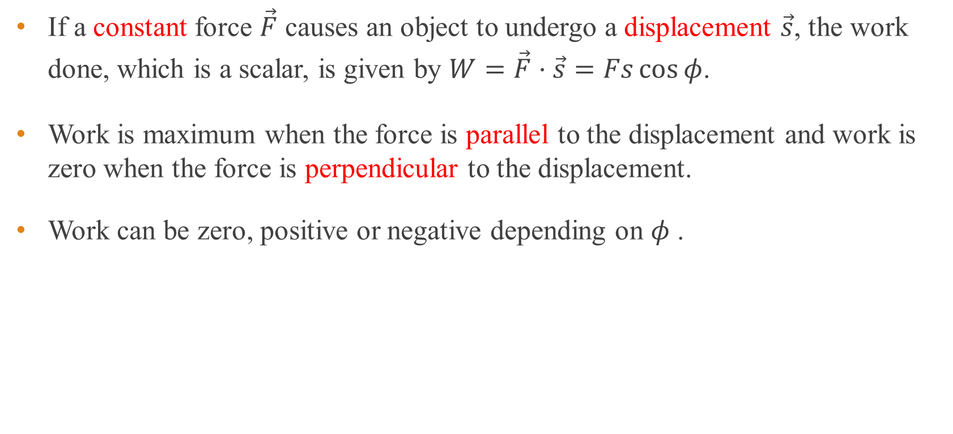



Application of dot product
If a constant force $\vec{F}$ causes an object to undergo a displacement $\vec{s}$, the work done, which is a scalar, is given by $W=\vec{F}⋅\vec{s}=Fs\cos{φ}$.
Work is maximum when the force is parallel to the displacement and work is zero when the force is perpendicular to the displacement.
Work can be zero, positive or negative depending on $φ$ .
$$\vec{F}$$
$$\vec{F}$$
$$φ$$
$$φ$$
$$\vec{s}$$

Slide 27
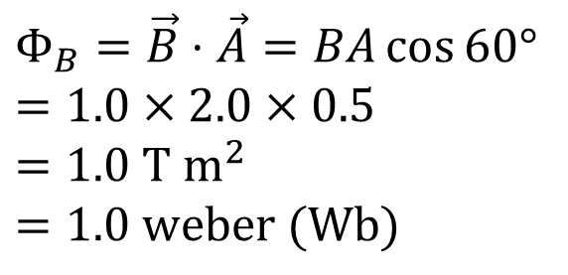
Example 6
Determine the magnetic flux $Φ_{B}$, where $Φ_{B}$ is defined as $Φ_{B}=\vec{B}⋅\vec{A}$. Assume that $\vec{B}$ and $\vec{A}$ are at 60$°$ to each other and B is 1.0 tesla (T) and A is 2.0 m².
$$Φ_{B}=\vec{B}⋅\vec{A}=BA\cos{60°}$$
$$=1.0×2.0×0.5$$
$$=1.0 \text{T} {\text{m}}^{2}$$
$$=1.0 \text{weber}\text{ (}\text{Wb}\text{)}$$

Slide 28

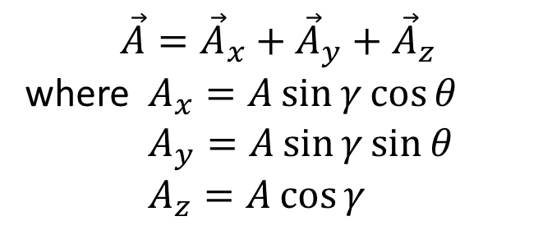




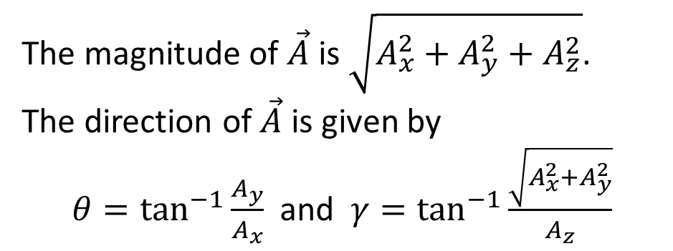

Resolving vectors in 3D
A vector $\vec{A}$ in 3D can be resolved into three mutually perpendicular components as follow :
z
$$\vec{A}={\vec{A}}_{x}+{\vec{A}}_{y}+{\vec{A}}_{z}$$
where $A_{x}=A\sin{γ}\cos{θ}$
$A_{y}=A\sin{γ}\sin{θ}$
$A_{z}=A\cos{γ}$
$${\vec{A}}_{z}$$
$$\vec{A}$$
$$γ$$
$${\vec{A}}_{y}$$
The magnitude of $\vec{A}$ is $\sqrt{A_{x}^{2}+A_{y}^{2}+A_{z}^{2}}$.
The direction of $\vec{A}$ is given by
$θ=\tan^{−1}{\frac{A_{y}}{A_{x}}}$ and $γ=\tan^{−1}{\frac{\sqrt{A_{x}^{2}+A_{y}^{2}}}{A_{z}}}$
y
$${\vec{A}}_{x}$$
$$θ$$
x

Slide 29
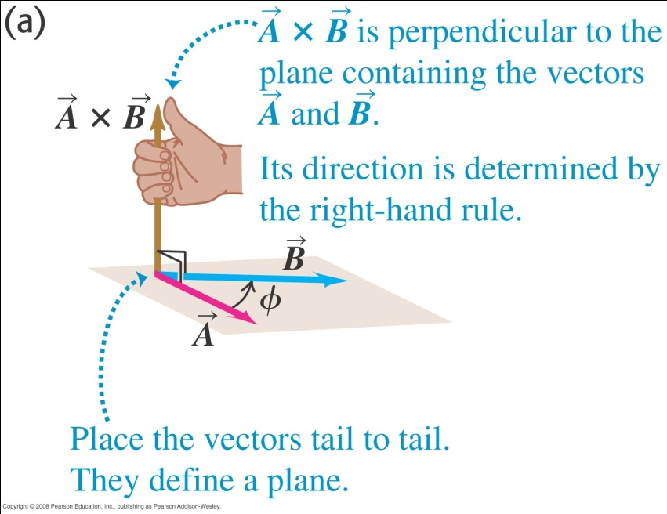





Cross (vector) product
The cross product of two vectors $\vec{A}$ and $\vec{B}$ is defined by $\vec{C}=\vec{A}×\vec{B}.$
The magnitude of $\vec{C}$ is given by $C=AB\sin{φ}$, where $0°≤φ≤180°$.
The direction of $\vec{C}$ is perpendicular to both $\vec{A}$ and $\vec{B}$ and can be obtained using the right hand grip rule.
$$\vec{C}=\vec{A}×\vec{B}$$
$$\vec{B}$$
$$φ$$
y
$$\vec{A}$$
x

Slide 30
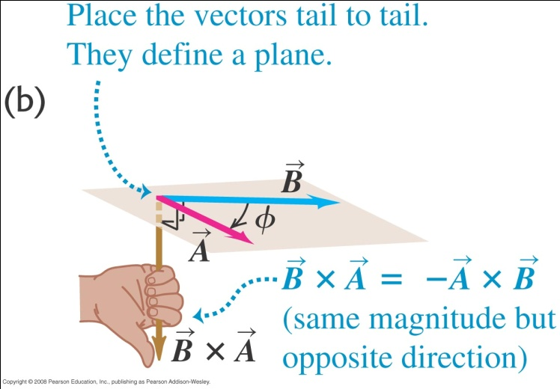

Right hand grip rule
If $\vec{B}$ is rotated about a perpendicular line until it is aligned with $\vec{A}$, the thumb points in the direction of $\vec{B}×\vec{A}$.
In other words, $\vec{A}×\vec{B}=−\vec{B}×\vec{A}$.

Slide 31
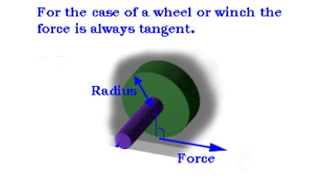


Application of cross product
The vector $\vec{τ}=\vec{r}×\vec{F}$ is known as torque where $\vec{r}$ is the radius vector and $\vec{F}$ is the force vector.
The magnitude of $\vec{τ}$ is known as the moment (turning effect) of the force.
The direction of $\vec{τ}$ is given by the right hand grip rule. Animation
$$\vec{τ}=\vec{r}×\vec{F}$$

Slide 32
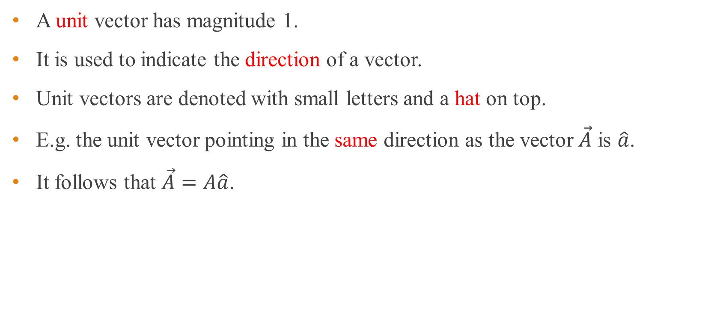
Unit vector
A unit vector has magnitude 1.
It is used to indicate the direction of a vector.
Unit vectors are denoted with small letters and a hat on top.
E.g. the unit vector pointing in the same direction as the vector $\vec{A}$ is $\hat{a}$.
It follows that $\vec{A}=A\hat{a}$.

Slide 33



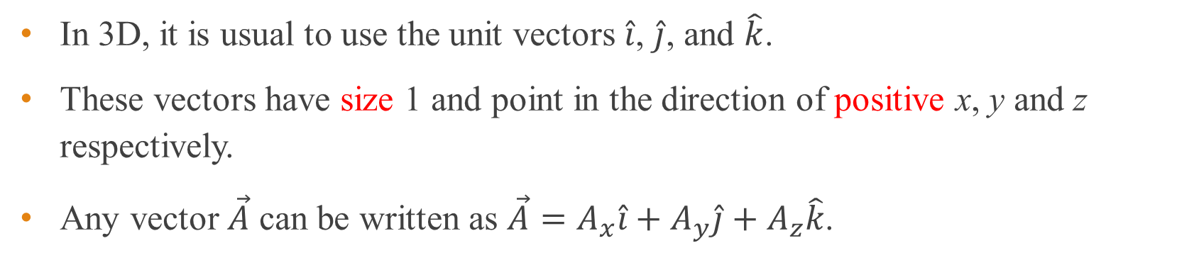




Unit vectors in 3D
In 3D, it is usual to use the unit vectors $\hat{i}$, $\hat{j}$, and $\hat{k}$.
These vectors have size 1 and point in the direction of positive x, y and z respectively.
Any vector $\vec{A}$ can be written as $\vec{A}=A_{x}\hat{i}+A_{y}\hat{j}+A_{z}\hat{k}$.
z
z
$$A_{z}\hat{k}$$
$$\hat{k}$$
$$\vec{A}$$
$$\hat{j}$$
$$\hat{i}$$
$$A_{x}\hat{i}$$
$$A_{y}\hat{j}$$
x
y
y
x

Slide 34

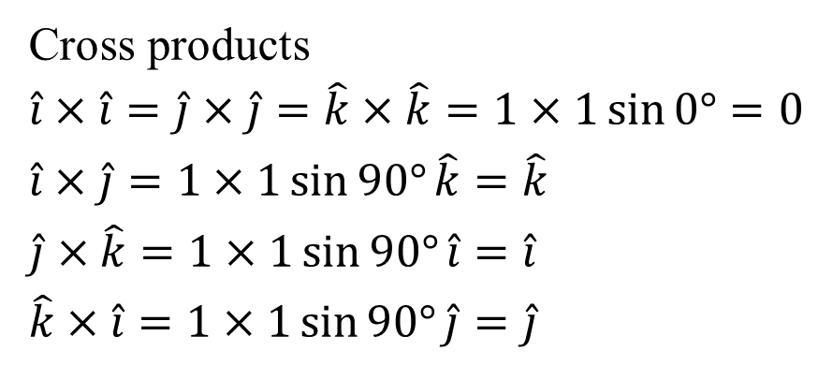
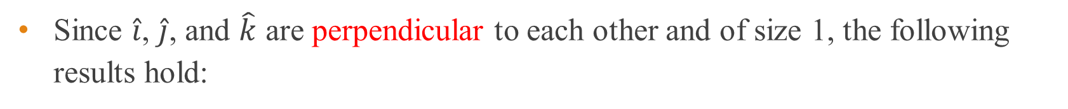
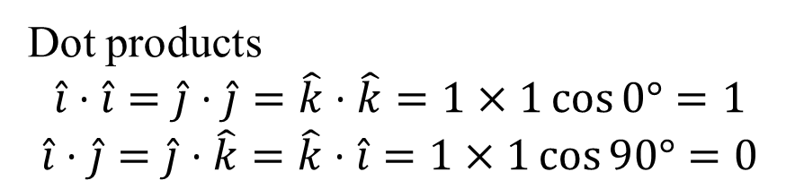


Unit vector operations in 3D
Since $\hat{i}$, $\hat{j}$, and $\hat{k}$ are perpendicular to each other and of size 1, the following results hold:
Dot products
$$\hat{i}⋅\hat{i}=\hat{j}⋅\hat{j}=\hat{k}⋅\hat{k}=1×1\cos{0°}=1$$
$$\hat{i}⋅\hat{j}=\hat{j}⋅\hat{k}=\hat{k}⋅\hat{i}=1×1\cos{90°}=0$$
z
$$\hat{k}$$
$$\hat{j}$$
$$\hat{i}$$
Cross products
$$\hat{i}×\hat{i}=\hat{j}×\hat{j}=\hat{k}×\hat{k}=1×1\sin{0°}=0$$
$$\hat{i}×\hat{j}=1×1\sin{90°}\hat{k}=\hat{k}$$
$$\hat{j}×\hat{k}=1×1\sin{90°}\hat{i}=\hat{i}$$
$$\hat{k}×\hat{i}=1×1\sin{90°}\hat{j}=\hat{j}$$
x
y

Slide 35
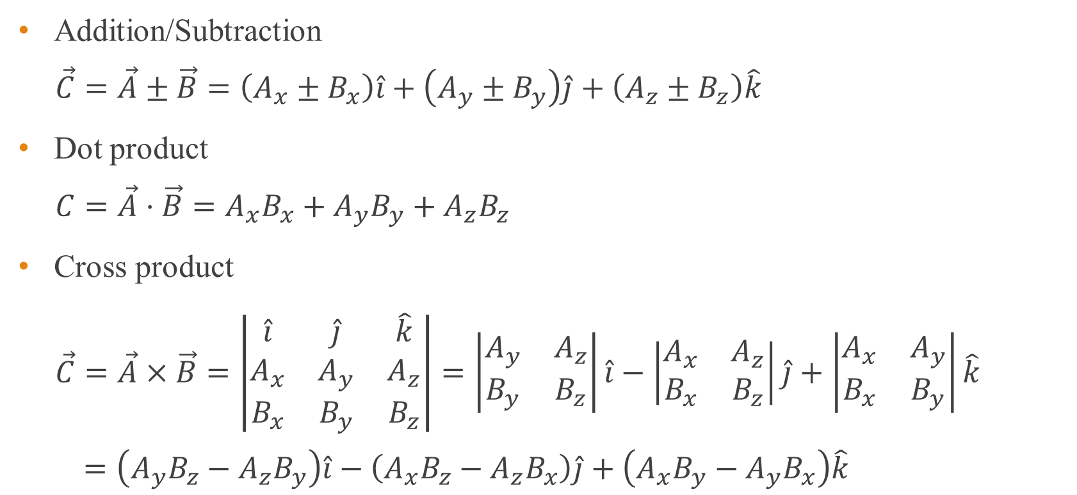
Vector operations using unit vectors
Addition/Subtraction
$$\vec{C}=\vec{A}±\vec{B}=\left(A_{x}±B_{x}\right)\hat{i}+\left(A_{y}±B_{y}\right)\hat{j}+\left(A_{z}±B_{z}\right)\hat{k}$$
Dot product
$$C=\vec{A}⋅\vec{B}=A_{x}B_{x}+A_{y}B_{y}+A_{z}B_{z}$$
Cross product
$$\vec{C}=\vec{A}×\vec{B}=\left|\begin{matrix}\hat{i} & \hat{j} & \hat{k} \\ A_{x} & A_{y} & A_{z} \\ B_{x} & B_{y} & B_{z}\end{matrix}\right|=\left|\begin{matrix}A_{y} & A_{z} \\ B_{y} & B_{z}\end{matrix}\right|\hat{i}−\left|\begin{matrix}A_{x} & A_{z} \\ B_{x} & B_{z}\end{matrix}\right|\hat{j}+\left|\begin{matrix}A_{x} & A_{y} \\ B_{x} & B_{y}\end{matrix}\right|\hat{k}$$
$$=\left(A_{y}B_{z}−A_{z}B_{y}\right)\hat{i}−\left(A_{x}B_{z}−A_{z}B_{x}\right)\hat{j}+\left(A_{x}B_{y}−A_{y}B_{x}\right)\hat{k}$$

Slide 36

Example 7
Given the position vectors $\vec{A}=3\hat{i}−4\hat{j}+4\hat{k}$ and $\vec{B}=2\hat{i}+3\hat{j}−7\hat{k}$, find
a) $\vec{A}+\vec{B}$
b) $\vec{A}−\vec{B}$
in terms of x, y and z components.
Notes:
A + B = 5i – j – 3k
A – B = i – 7j – 11k

Slide 37
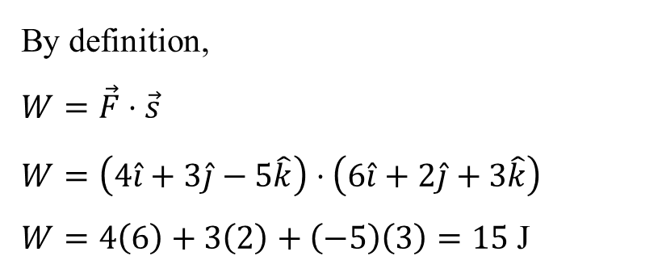
Example 8
A force $\vec{F}=4\hat{i}+3\hat{j}−5\hat{k}$ N acts on an object and produces a displacement $\vec{s}=6\hat{i}+2\hat{j}+3\hat{k}$ m. What is the work done?
By definition,
$$W=\vec{F}⋅\vec{s}$$
$$W=\left(4\hat{i}+3\hat{j}−5\hat{k}\right)⋅\left(6\hat{i}+2\hat{j}+3\hat{k}\right)$$
$W=4\left(6\right)+3\left(2\right)+\left(−5\right)\left(3\right)=15$ J

Slide 38
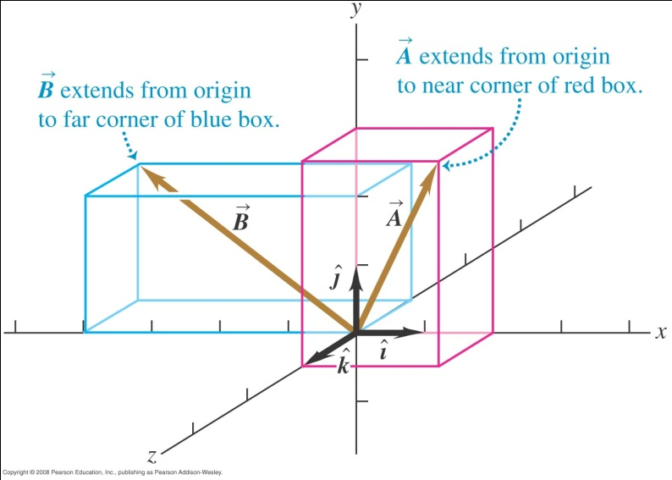
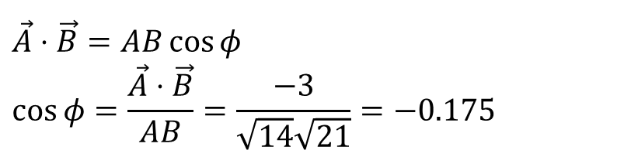
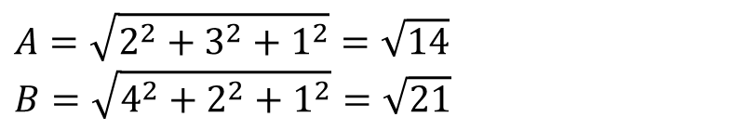
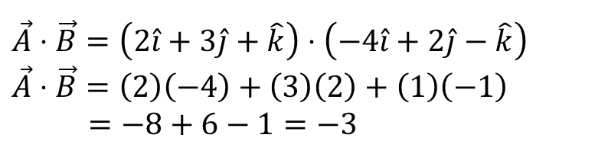
Example 9
Find the angle between the two vectors $\vec{A}=2\hat{i}+3\hat{j}+\hat{k}$ and $\vec{B}=−4\hat{i}+2\hat{j}−\hat{k}$.
$$\vec{A}⋅\vec{B}=\left(2\hat{i}+3\hat{j}+\hat{k}\right)⋅\left(−4\hat{i}+2\hat{j}−\hat{k}\right)$$
$$\vec{A}⋅\vec{B}=\left(2\right)\left(−4\right)+\left(3\right)\left(2\right)+\left(1\right)\left(−1\right)$$
$$=−8+6−1=−3$$
$$A=\sqrt{2^{2}+3^{2}+1^{2}}=\sqrt{14}$$
$$B=\sqrt{4^{2}+2^{2}+1^{2}}=\sqrt{21}$$
$$\vec{A}⋅\vec{B}=AB\cos{φ}$$
$$\cos{φ}=\frac{\vec{A}⋅\vec{B}}{AB}=\frac{−3}{\sqrt{14}\sqrt{21}}=−0.175$$
$$φ=\cos^{−1}{−0.175}=100°$$

Slide 39

Example 10
A force $\vec{F}=4\hat{i}+3\hat{j}−5\hat{k}$ N acts on an object with position vector $\vec{r}=6\hat{i}+2\hat{j}+3\hat{k}$ m. What is the torque about the origin?
By definition,
$$\vec{τ}=\vec{r}×\vec{F}$$
$$\vec{τ}=\left(6\hat{i}+2\hat{j}+3\hat{k}\right)×\left(4\hat{i}+3\hat{j}−5\hat{k}\right)$$
$$=\left|\begin{matrix}\hat{i} & \hat{j} & \hat{k} \\ 6 & 2 & 3 \\ 4 & 3 & −5\end{matrix}\right|=\left|\begin{matrix}2 & 3 \\ 3 & −5\end{matrix}\right|\hat{i}−\left|\begin{matrix}6 & 3 \\ 4 & −5\end{matrix}\right|\hat{j}+\left|\begin{matrix}6 & 2 \\ 4 & 3\end{matrix}\right|\hat{k}$$
$$=−19\hat{i}+42\hat{j}+10\hat{k} \text{Nm}$$

Slide 40
End of chapter

